Slide 1
Lending Club Case Study
A Lending company is about to take some business decision so we need to do some analysis on the basis of old data.

Slide 2
Data Understanding
Take a look of data file manually.
Get the shape of data frame.
Get the overall description of data frame.
Size of data frames.
Get number of unique columns and rows.

Slide 3
Data Cleaning
Find the all duplicate values and remove it from actual dataframe and assign to it.
Find all null and missing values and replace them with some usefull data e.g. int or float if we have missing data in numeric columns.
Find outliner and try to remove it if not needed.
Try to get numeric values for the important columns,we are gonna need in analysis.
Try to merge two or more columns if needed.

Slide 4
Univariant Analysis
I the field of Lending or Loans we have some fixed import columns like loan_amount , total_payment ,annual_income,loan_status.
loan_amount , total_payment ,annual_income, should be in numeric format for sure.
Did univariant analysis for loan_amount , total_payment ,annual_income,loan_status.
Get relation between any two or three attribute and plot for each.

Slide 5
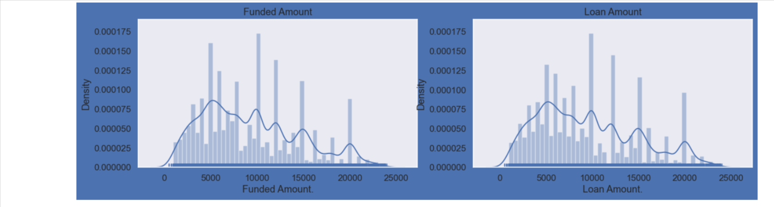
Loan Amount Vs Funded Amount

Slide 6
Conclusion
Most of the people do payback there loans depending on the annual income and house owning condition.
The people who have taken loan for depth consolidation are the higher in paying it back at full.
The people who have taken loan for depth consolidation are also the higher in charged off.
People with higher annual income are more likely to pay it back are less in defaulter.
Less people lie between the full paying status and defaulter status.

Slide 7
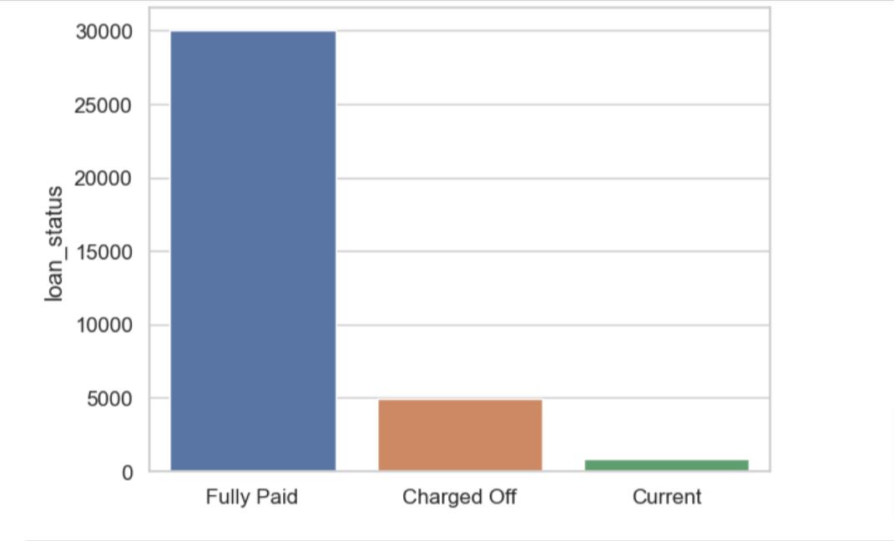
Loan status vs number of loan application

Slide 8
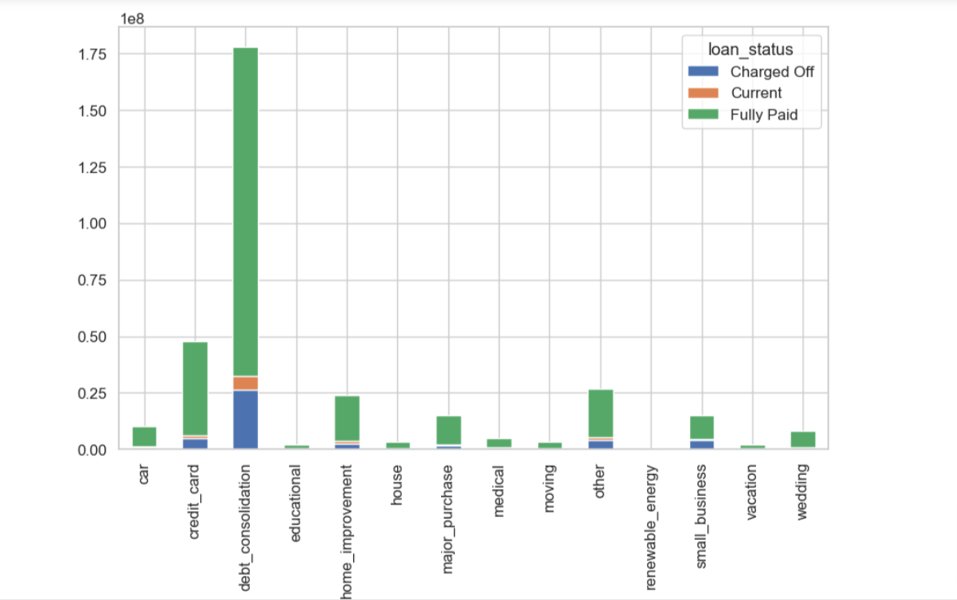
Loan Status Vs Loan Purpose

